Slide 1
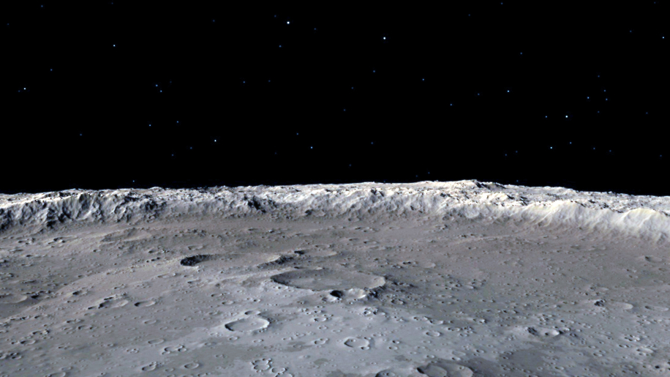

HSML Schema Updates
Registration, Authentication & Authorization
Alicia Sanjurjo Barrio (345C – Affiliate)
03/27/2025

Slide 2

Updates
Test of DoD Simulation with new HSML using FUTURAMA in the lab was successful for Unity and Omni, but it is not working with Unreal
HSML API and Web App Registration test successful using FUTURAMA
HSML API has been set up in EC2 (by Sydni), but unable to test it yet
Web App working with HSML API but needs some refinements
Testing sending messages through HSML API hosted in FUTURAMA
Found some bugs in the code that I need to fix
Unable to perform this HSML DoD Test with EC2 due to issues with Kafka Server inside EC2, unable to reach it outside

Slide 3
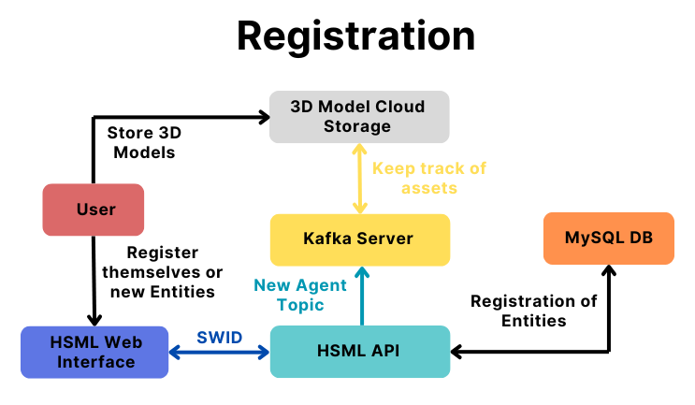
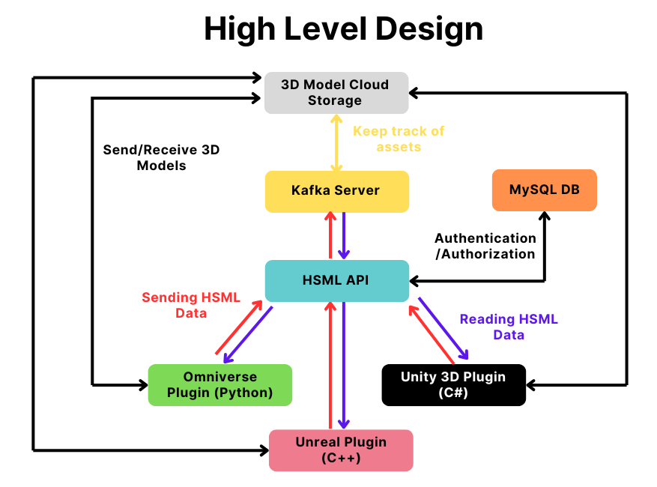
Demo System Architecture
Modified from Jared’s Figure

Slide 4

HSML API Architecture
EC2/FUTURAMA
HSML Web App
Registration
User
Kafka Server
Producer BL
Producer Authentication
HSML API
Platform
MySQL DB
Consumer BL
Consumer Authorization

Slide 5
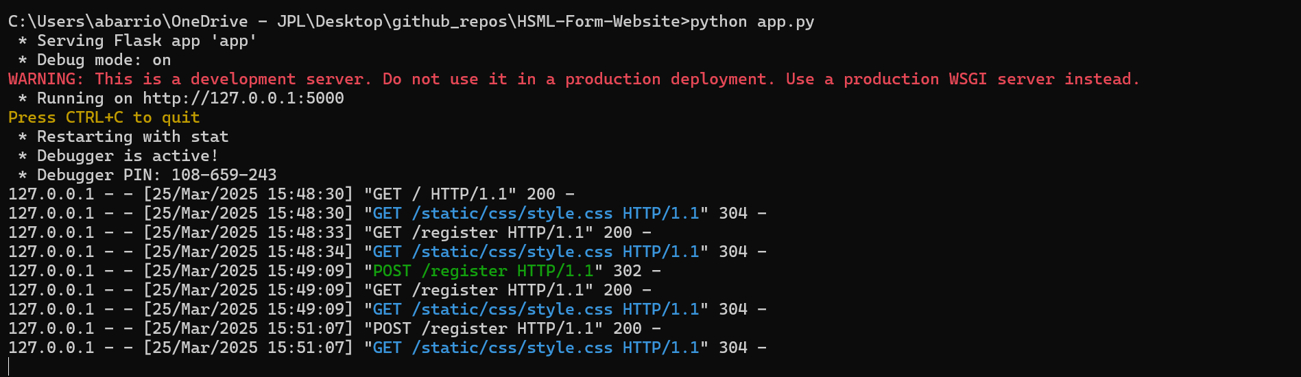
Registration Test: HSML Web App + HSML API
HSML Web App

Slide 6
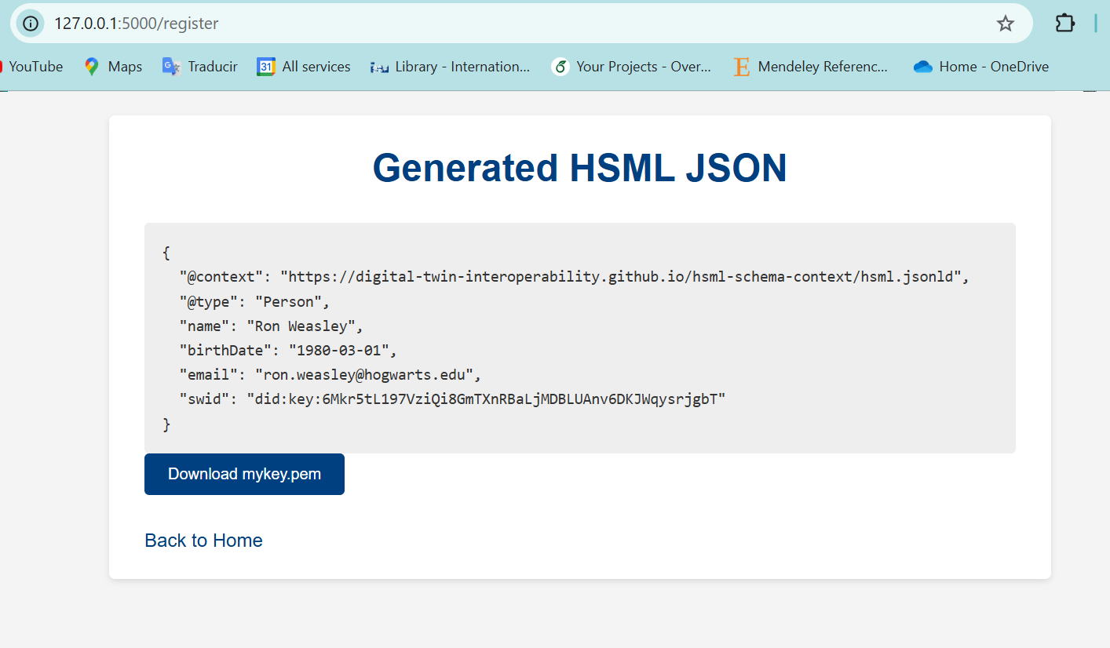
Registration Test: HSML Web App + HSML API
HSML Web App

Slide 7
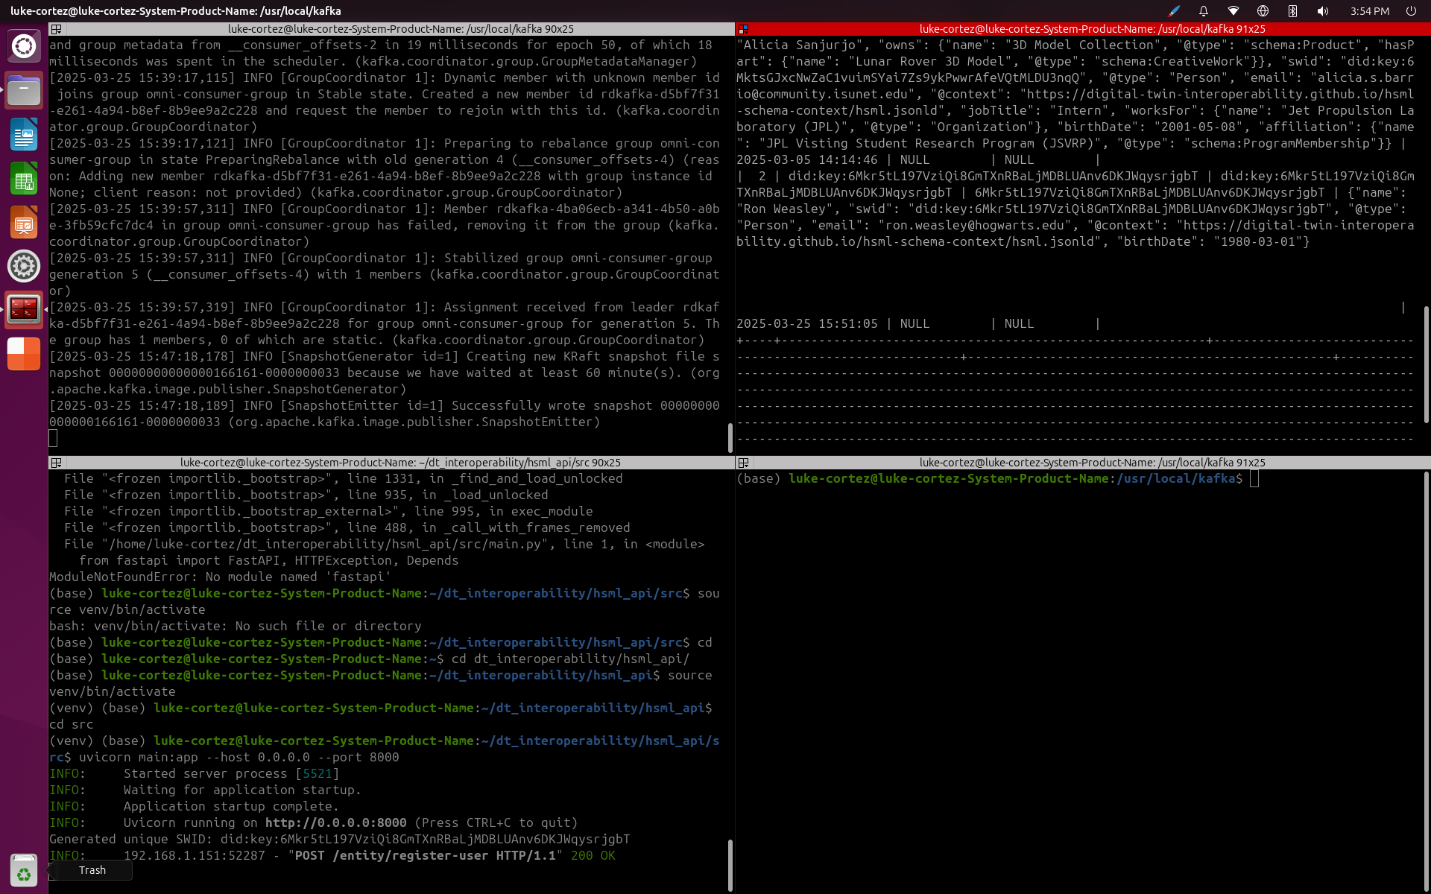
Registration Test: HSML Web App + HSML API
Kafka
MySQL DB
HSML API

Slide 8
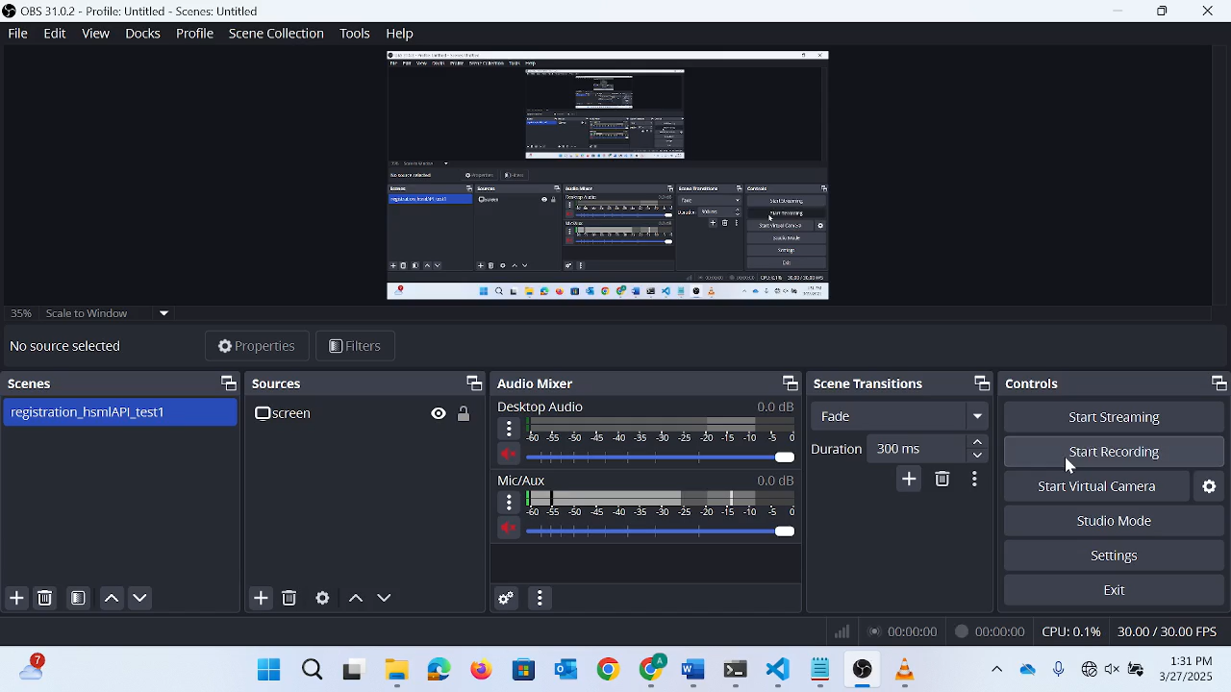
Registration Test: HSML Web App + HSML API

Slide 9
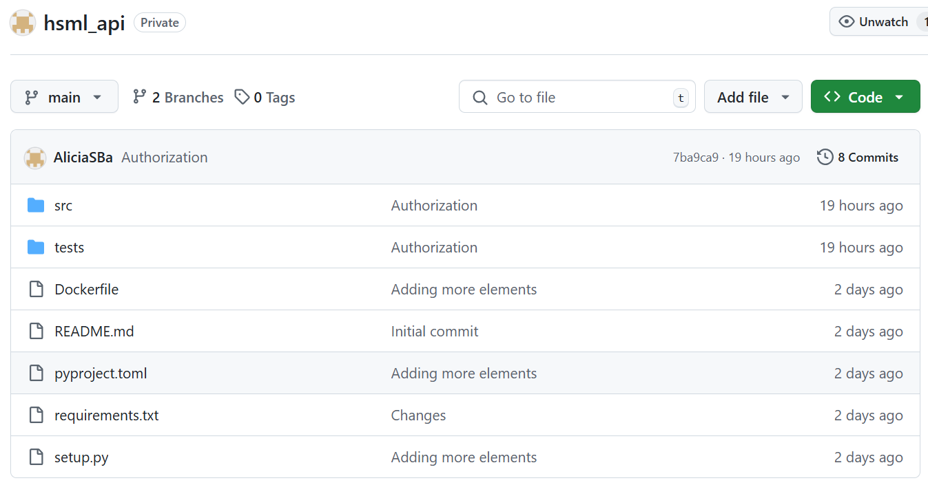
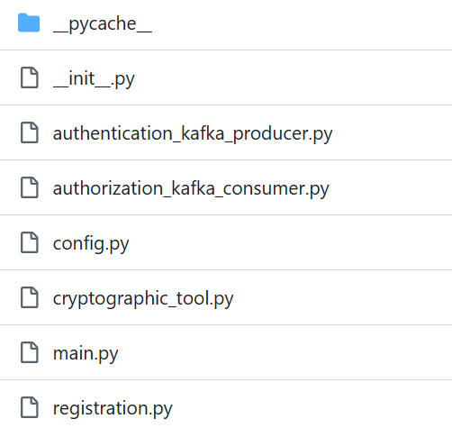
HSML API Package
router
router
APP
router

Slide 10
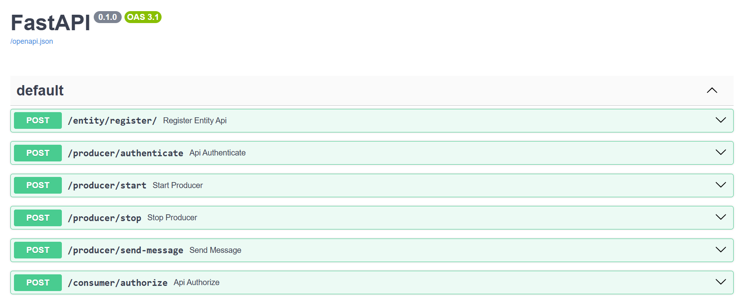
HSML API - FastAPI docs

Slide 11
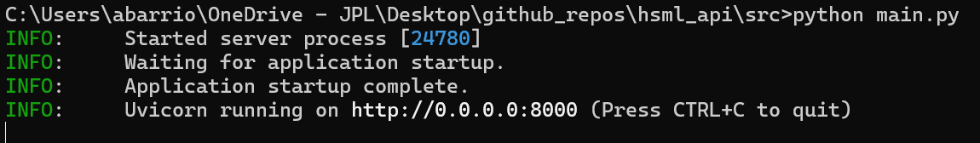
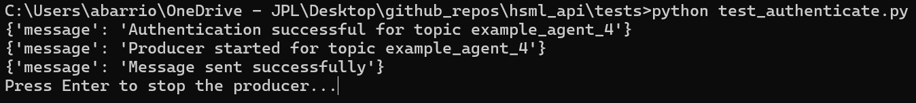
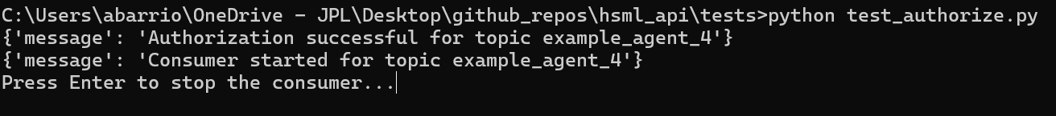
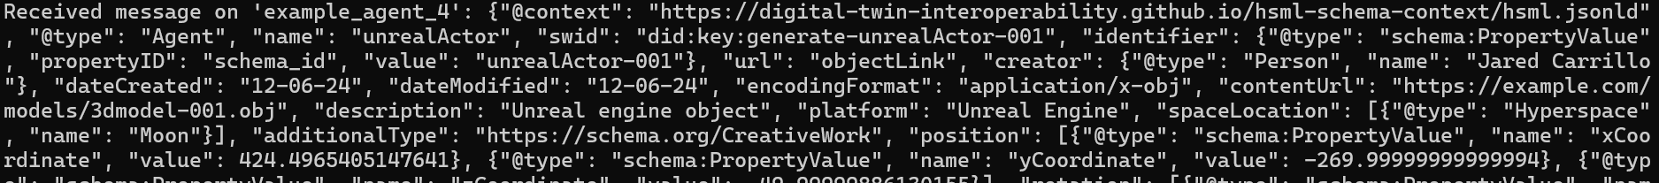
HSML API from the terminal
HSML API
Producer (Agent 4)
Consumer (Agent 4)
Message (HSML JSON)

Slide 12
HSML API Architecture
EC2/FUTURAMA
HSML Web App
Registration
User
Kafka Server
Producer BL
Producer Authentication
HSML API
Platform
MySQL DB
Consumer BL
Consumer Authorization

Slide 13
ADDITIONAL SLIDES

Slide 14
Comments about VERSES Feedback
“Limitations of Schema.org centric approach.”
However, our schema is HSML centric, its structure follows the HSML ontology. We are only using the existing Schema.org properties, to save time in development.
Schema.org is just the starting point, other schemas can be added in the future. We also develop our own domain-specific properties needed for the demo and to conform to HSML.
The Schema.org Types used are a close match, we do not mean for them to be understood as the same. It is just a pool to draw properties from.
So, maybe we need to improve the wording of our document, to make these points clearer.
“Domain-specific ontologies” – True, more ontologies can be added in the future within the HSML one.
“Upper Ontology” – I don’t know exactly what they are referring to with this.
“Flexibility and Scalability” – Flexibility is a good suggestion, however their suggestions for scalability could maybe lead to a future interoperability issue.

Slide 15



Test by 3/13
TEST 1: DoD test with HSML (in JPL LAB)
Updates
3 Platforms – Unreal Environment Setup missing in the Lab (Jared)
Kafka Server – Try FUTURAMA, if not use EC2. (Sydni, Gerald, Alicia)
Modified Scripts to HSML (Sohee, Alicia)
Evaluation Metrics – Latency Measurement. Message throughput. Packet Loss… (Gerald, Gabriel)
Producer Rovers in old configuration – Viper (Unity), Cadre (Omni), Cadre (Unreal). Make corresponding topics in local and EC2 server. (Sydni, Gerald)
Also, test scalability by modifying # Consumers & measuring Performance (latency, throughput & CPU usage)
NOTE: No HSML API, no new BL plugin logic, no path planning… in this test
FUTURAMA works
Can I already use it with the FUTURAMA Kafka server?
3rd Terminal Problem
Test ready to be done using FUTURAMA server (3/14 - 3/17)

Slide 16
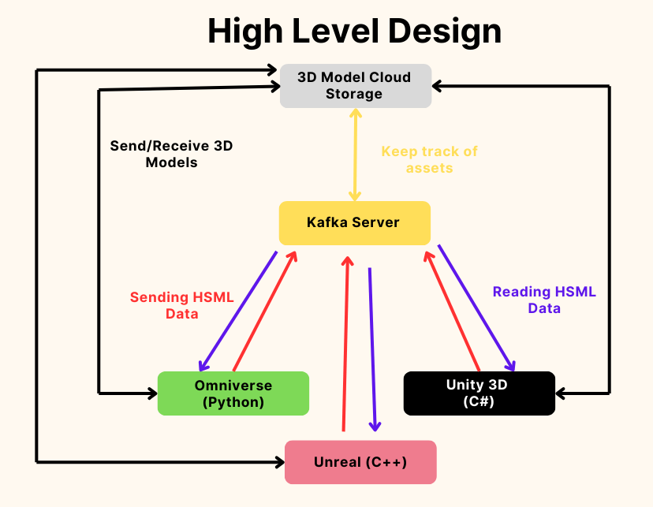
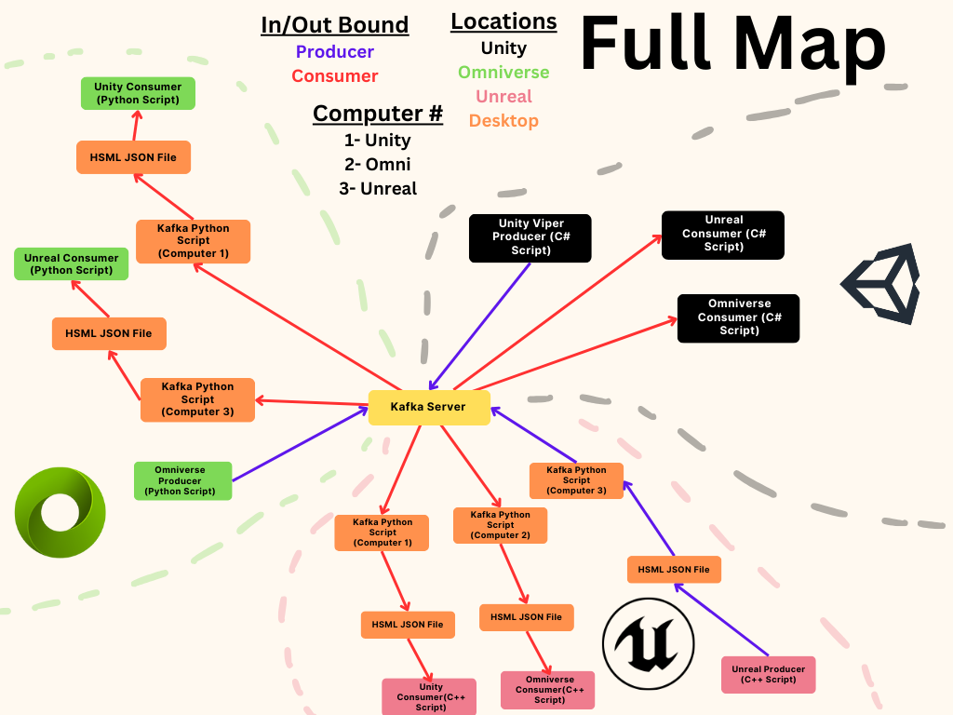
DoD System Architecture
Kafka Server
Jared’s Figures

Slide 17
Test by 3/20
TEST 2: Minimal Demo Test (with HSML API)
3 Platforms (Jared, Aaron, Joshua)
New Producer Rovers Setup – ex: Viper A (Unity), Cadre (Omni), Viper B (Unreal) (Jared, Aaron, Joshua)
Kafka Server – FUTURAMA or EC2 (Sydni, Gerald, Alicia)
New BL Scripts connecting to HSML API (not to Kafka directly) (Gerald, Alicia, Sohee)
Use new naming convention for files (ex: ViperAOmniConsumer.py)
HSML API – host as Python package inside FUTURAMA and EC2 (Alicia, Niki)
MySQL DB – FUTURAMA or EC2 (Alicia, Sydni)
HSML Web App – connect with HSML API (Gerald, Alicia)
Registration of Users, Agents (+ Kafka topics), and Credentials (Alicia, Niki)
Simple Path Planning for Viper A (to reach Cadre) (Diego)
Evaluation Metrics (Gerald, Gabriel)

Slide 18
General Tasks needed for Next Week (TEST 2)
Simulation in the 3 Platforms: same environment in all 3, which Rover is going to be producing/consuming in each platform (ex: Viper A (Unity), Cadre (Omni), Viper B (Unreal)), simple path planning, collisions working
EC2 working: DDNS domain or alternative
HSML API set up and connected to MySQL DB and Kafka (EC2/FUTURAMA)
HSML Web App connected to HSML API
Modified BL Plugin Scripts of each platform to connect to HSML API, and with the new sent parameters
Evaluation Metrics working and ready to be used in testing
Register Users, Agents (+ Kafka topics), and Credentials for each rover
Perform TEST 2

Slide 19
My Next Tasks
Modify Authentication/Authorization API to fit new BL plugin better
Create new properties in HSML Schema needed for the demo
Test updated Registration API using MySQL DB in FUTURAMA server
TEST 1: Test with the 3 Platforms with the updated HSML scripts in the Lab
Fix DoD Cadre scripts, and test with the old DoD scripts with Unreal first
Update coordinate system or anything needed in the HSML scripts
Incorporate the latency tracker
Make HSML API into a Python package and set it up in both FUTURAMA and EC2 server to be accessible
New BL plugins: Modify BL scripts to connect to HSML API (not Kafka)

Slide 20
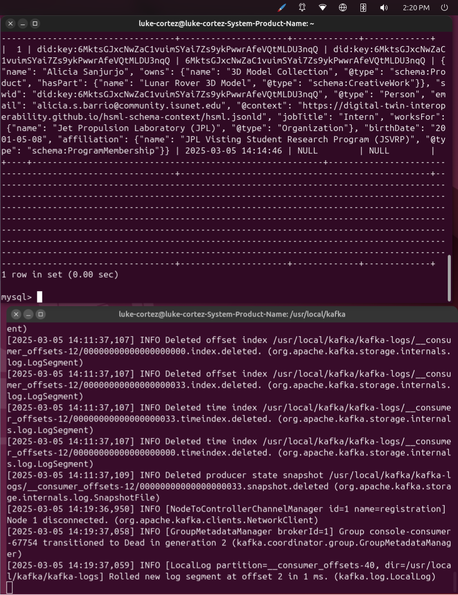
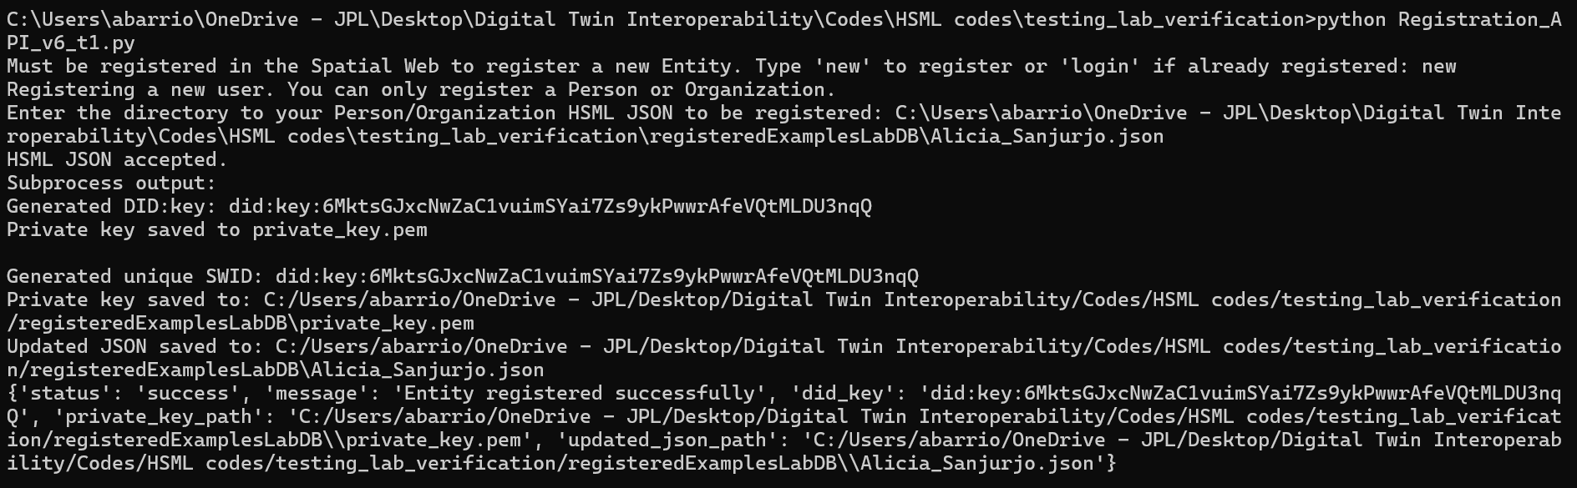
MySQL DB – Lab Computer Setup
First Test - Registering the First User. Using FUTURAMA for Kafka Server and MySQL server.
NOTE: I have also set up the MySQL DB in the EC2 instance, but I still haven’t tested connecting it with the HSML API for Registration.

Slide 21





Verification in the Spatial Web
In the example, this Credential now has authorized Agent 2 to have access to Agent 4’s data
Producer
Consumer
Agent 4
“did:key:6MkhaP2tuJVTJQ16Xna4yqXn9hD3a32ermE82niVS4kF2t1"
Agent 2
“did:key:6Mkq47kEVpasYSLxc2DM1951tSw2hPQyT7nhdVrnT6YawM5”
Check Registry of DIDs
Credential Access Agent 4
"did:key:6MksdVt3yzWsrYF3DCpgmeDzL9QGm3cwXQTewVsV3n25isQ"
In the Credential is where it is written that Agent 2 (did:key:123) has access to Agent 4 (did:key:xyz)
Notes:
The unique identifier is generated through a cryptographic process, this makes it impossible to guess the underlying key or DID

Slide 22
Verification: Authentication & Authorization
User is prompted to provide their private_key.pem to identify themselves before being allowed to act as a producer/consumer in the Kafka topic:
Authentication of Kafka Producer API:
Asks for path to private key of producer Agent to use as password/identification.
Public key did:key is derived from private_key.pem using CLI tool.
Checks against MySQL Registry that did:key generated is the did of the Agent associated to that topic_name
If successful, producer can start publishing data in the Kafka topic for the Agent.
Authorization of Kafka Consumer API:
Asks for path to private key of consumer Entity to use as password/identification.
Public key did:key is derived from private_key.pem using CLI tool.
Checks against MySQL Registry that did:key generated is inside the allowed_did of the producer Agent associated to that topic_name
If successful, consumer can start subscribing to the data in the Kafka topic.

Slide 23
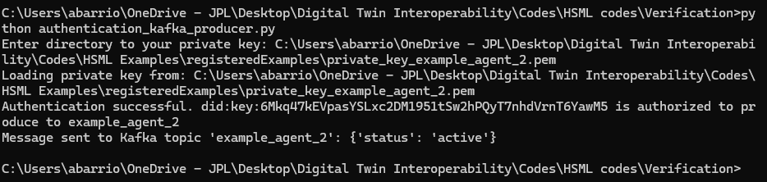
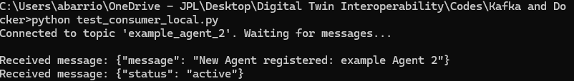
HSML API Initial Development
Authentication of Kafka Producer:
Checking that message was sent by connecting with a regular Consumer:
Notes:
The unique identifier is generated through a cryptographic process, this makes it impossible to guess the underlying key or DID

Slide 24
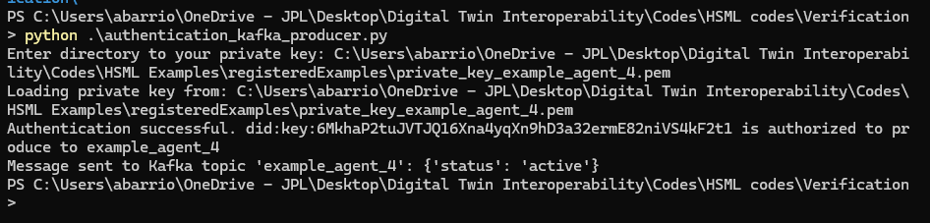
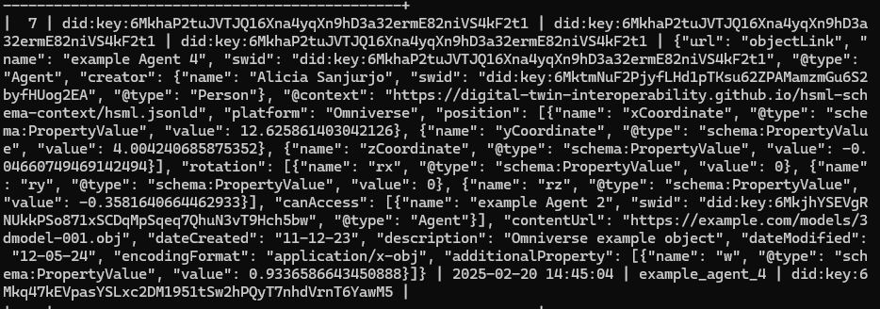
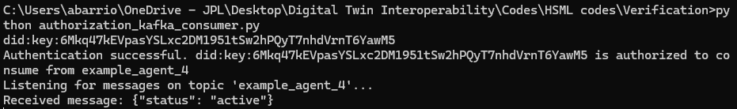
HSML API Initial Development
Authorization of Kafka Consumer:
Test of the authorization code using the example Agent 2 trying subscribe to Agent 4’s kafka topic called “example_agent_2”
‘Agent 4’ acting as a Producer
‘Agent 4’ entry in the MySQL database
(Agent 2’s SWID is in the allowed_did giving it access)
‘Agent 2’ acting as a Consumer
Notes:
The unique identifier is generated through a cryptographic process, this makes it impossible to guess the underlying key or DID

Slide 25
Possible Evaluation Metrics
URGENT. Who can work on tracking these?
Latency (End-to-End Delay)
Message Throughput
Packet Loss or Message Drop Rate
Synchronization Accuracy
Scalability: Number of Consumers vs. Performance
Resource Usage (CPU, RAM…)
Should be ready before 3/17 (so that we can test before 3/20)

Slide 26
Verification: Entity Registration system
User is prompted to upload their HSML JSON file of the new Entity they want to register.
Develop a Python API that:
Validates the JSON file (format, mandatory fields, and type check).
Checks for existing swid and warns the user if it will be overwritten.
Generates the did:key key pair using the CLI tool.
Attaches the did:key to the swid property in the JSON.
Stores the public key and updated JSON in the MySQL database.
Provides the private key (private_key.pem) and updated JSON to the user.

Slide 27
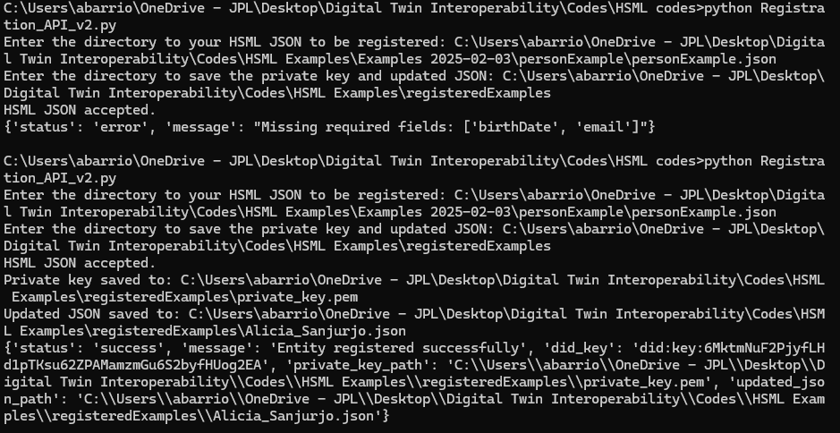
Registration API Initial Development
Example of registering my User identity using a Person HSML JSON using Python API:
There are certain mandatory fields to fill according to the Entity class
Notes:
The unique identifier is generated through a cryptographic process, this makes it impossible to guess the underlying key or DID

Slide 28
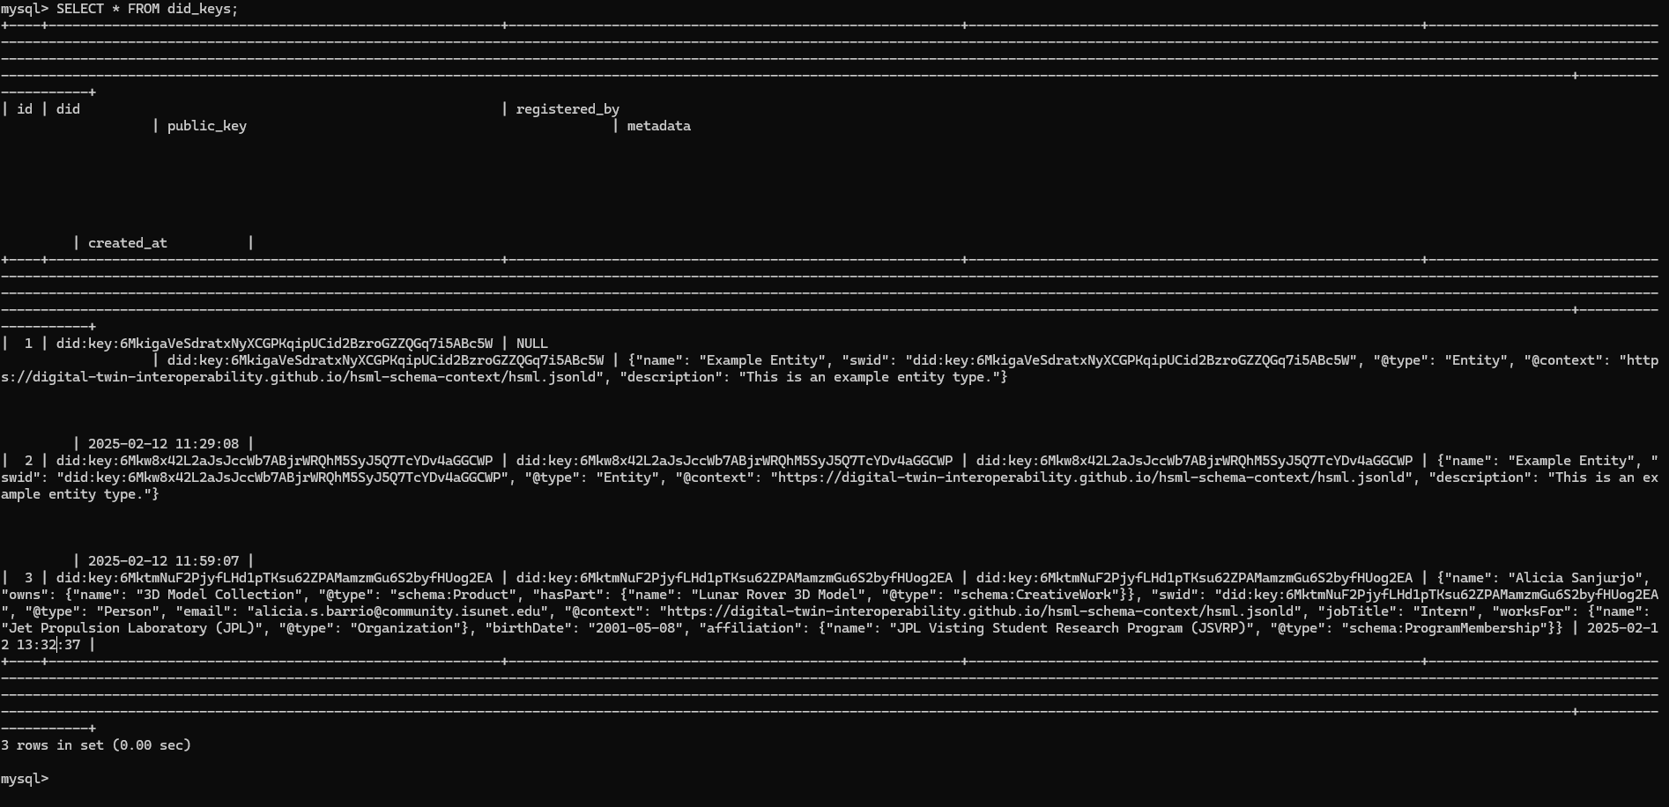
Registration API Initial Development
DID:key public key and HSML JSON with the metadata gets registered in MySQL database
Notes:
The unique identifier is generated through a cryptographic process, this makes it impossible to guess the underlying key or DID

Slide 29
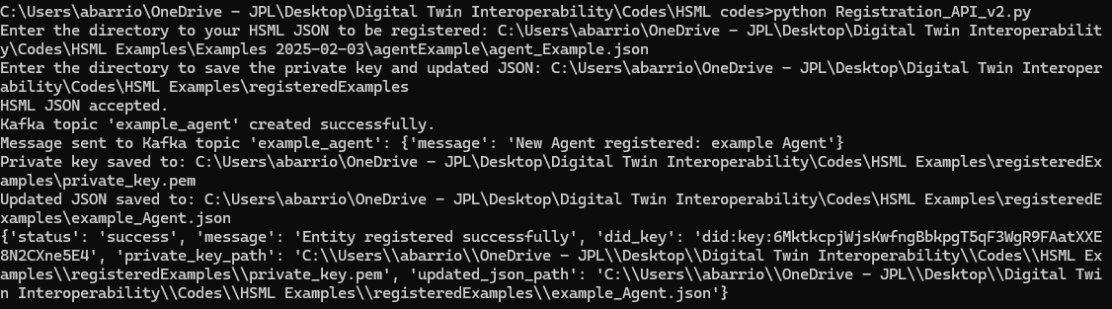
Registration API Initial Development
Example of registering and Agent HSML JSON using Python API:
Notes:
The unique identifier is generated through a cryptographic process, this makes it impossible to guess the underlying key or DID

Slide 30
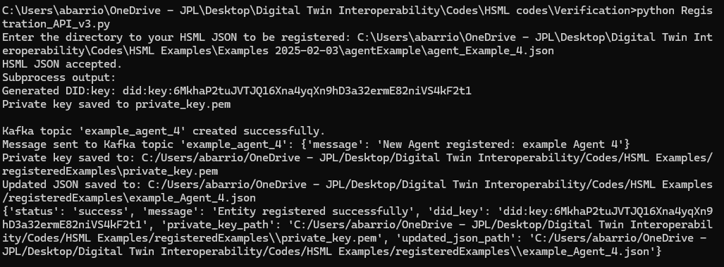
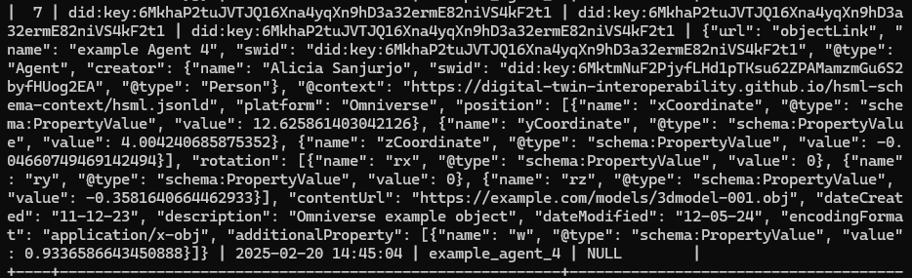
Registration API Initial Development
Example of registering and Agent HSML JSON using Python API:
Added that kafka_topic name gets directly stored in the database
Notes:
The unique identifier is generated through a cryptographic process, this makes it impossible to guess the underlying key or DID

Slide 31
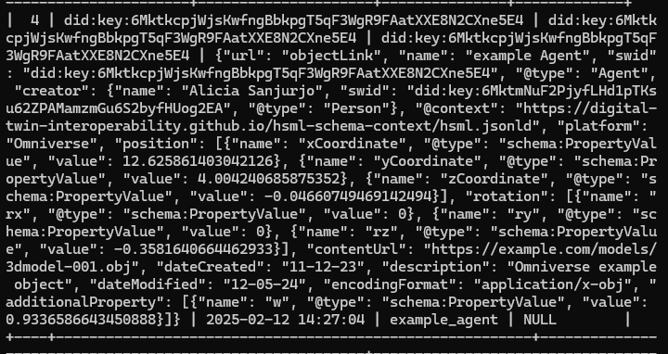
Registration API Initial Development
Also included in the database, to register the name of the topic associated to an Agent:
allowed_did column is empty for now as no Credential has been registered
Notes:
The unique identifier is generated through a cryptographic process, this makes it impossible to guess the underlying key or DID

Slide 32
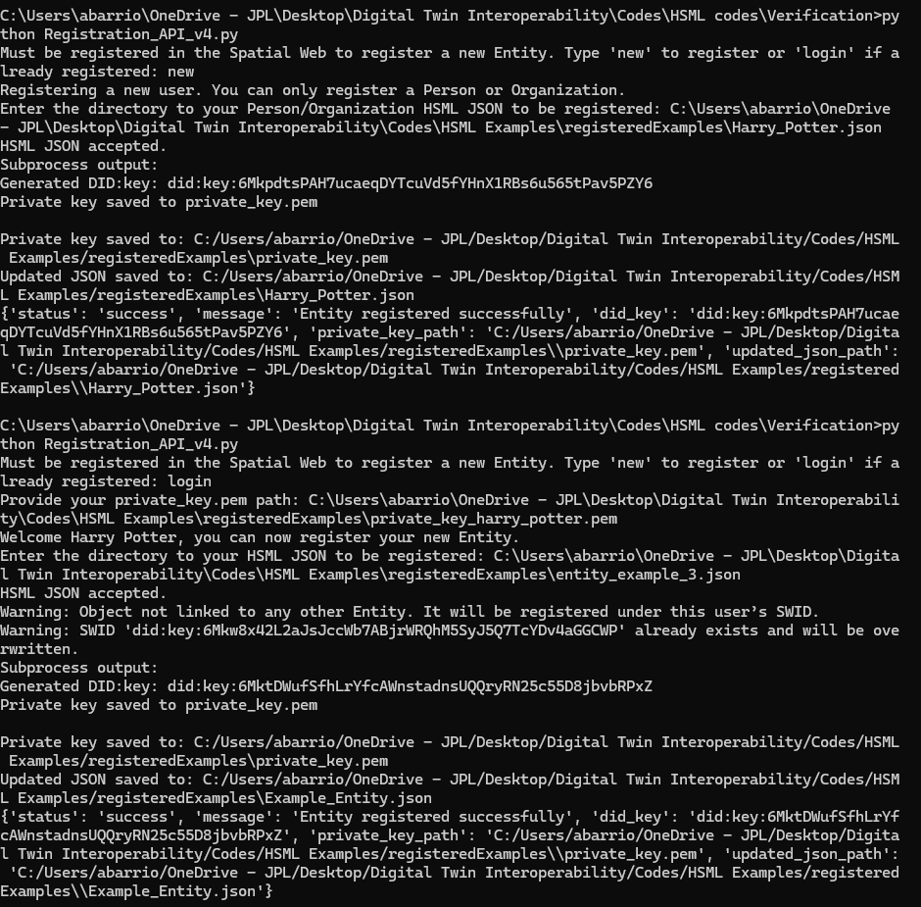
Registration API Initial Development
New Log In interface. Users (Person/Organization) must register themselves first before they can register another Entity (i.e., an Agent):
New User registering themselves
Existing User logging in and registering a new Entity
Notes:
The unique identifier is generated through a cryptographic process, this makes it impossible to guess the underlying key or DID

Slide 33
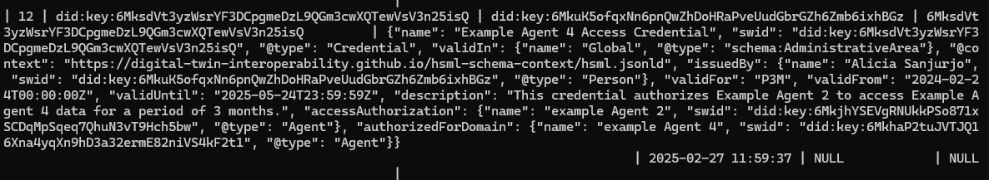
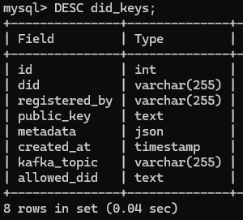
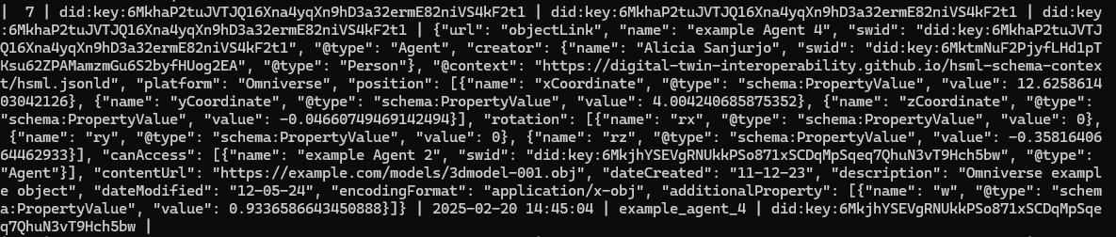
Registration API Initial Development
Registering a Credential so that Agent 2 can now have access to Agent 4’s data:
‘Agent 4 Access Credential’ entry in MySQL DB
JSON file in metadata has also been updated to have “canAccess” property
The allowed_did column of Agent 4 now has Agent 2’s SWID
Updated ‘Agent 4’ entry in MySQL DB
Notes:
The unique identifier is generated through a cryptographic process, this makes it impossible to guess the underlying key or DID

Slide 34
Build Verification Part
Test 1 - DoD test in JPL Lab
JPL Server or EC2 if needed
Test 2 - HSML with 3 Platforms
Modify Producer/Consumers & JSON files
Test 3 - Verification Test with Platforms
Deploy SQL Database in JPL Network
Test 4 - Rovers Use Case
HSML API with In-memory Database
Define Business Logic for UC
Isaac Sim Modeling of UC Scenario
Physics Simulation 3 Platforms
Build simple AI agent
Rovers Communication Relay
Krono & Omniverse connection
AI Agent integration with BL
UC Integration with pub-sub and HSML
Path planning with LLM
BL and physics integration with HSML API
Implement Verification in Use Case
Refine Demo and Clean up Code
Demo Dry Run

Slide 35
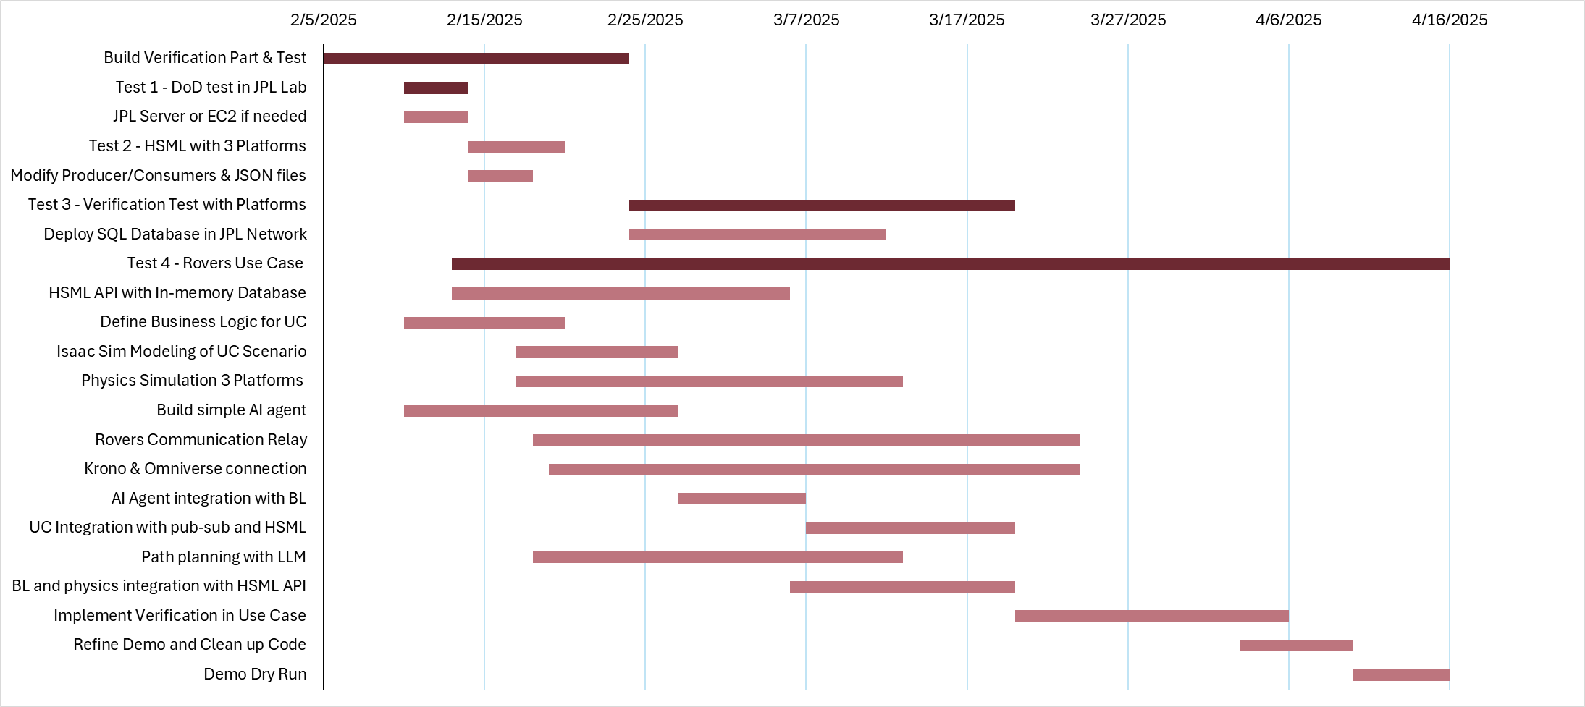

Slide 36

Group 3 Subtasks
GROUP 3: HSML Implementation; Model storage; Authentication protocol
Task 3. HSML Implementation into the 3 Platforms
3.1. Modify all JSON files to use HSML schema [2/19 – At Risk]
3.2. Adapt python/C++ Kafka Consumer/Producer scripts to HSML [2/19 – At Risk]
3.3. Test with the 3 Platforms that DoD demo works with HSML using lab’s Kafka server. Will require to first create the named topics in the scripts inside the server. NOTE: If server with local WiFi doesn’t work, try to use eduroam under same username for now. [2/20 – At Risk]
3.4. Identify which other properties are needed to incorporate the new data that will be sent in the Use Case; check if there is other existing ones that could work.
3.5. Integration of HSML API and BL plugin [3/20]

Slide 37
Group 3 Subtasks
GROUP 3: HSML Implementation; Model storage; Authentication protocol
Task 4. In-memory database along with Kafka (& with the HSML API)
4.1. Complete In-memory DB (Apache Ignite) setup and evaluation (also part of Group 1). Analyze if it can store .fbx, usd and .obj files… [2/17 - Delayed]
4.2. Evaluation and setup of MySQL together with Apache Ignite for Verification working with Kafka.
4.3. Set up MySQL database in a lab computer (maybe same one as Kafka server) and integrate with Kafka to be able to register Entities in the database through the server [3/12]
4.4. Integration of Apache Ignite with HSML API [3/10]
4.5. How storage method works with HSML (e.g., in the case of a Drive link, this link may have to appear inside the HSML JSON file)

Slide 38
Group 3 Subtasks
GROUP 3: HSML Implementation; Model storage; Authentication protocol
Task 6. Authentication Process for Kafka and HSML Entities
6.1. Set up MySQL database. Fields needed. How it works. NOTE: Right now, only using one table to store all Entities, evaluate if it would be better to use a table for each type of Entity, with different columns according to Entity.
6.2. Code to perform the Registration. Refinement. Testing. NOTE: Focus on Person, Agent, and Credential for now, and the relation between them. [2/20 – Off Track]
6.3. Code for the Verification side. User authentication before accessing topics. Use MySQL Database to check Authorization (based on Credentials). Integration with Kafka Server. [2/20 – Off Track]
6.4. Test Registration Verification with Basic Set-Up (without Platforms) [2/24 – At Risk]
6.5. Test Verification Process with the 3 Platform in the lab using Kafka server. [3/20]

Slide 39
Block Diagram of Needed Elements
Rover Control
(Manual & Scripts)
Simulation of Scene
Server Set-up
Get Consumer working inside Omni
Registration using MySQL DB
PhysX and Chaos Physics
In-memory DB
Platforms
Omniverse, Unity & Unreal
BL Plugin
HSML API
Kafka Server
PINN Connection
Collision across Platforms
Adjust BL to HSML API
Authentication
& Authorization
Model Permanent Storage
LLM Path planning
LLM BL & HSML Conversion
HSML Schema
new properties
AI Agent

Slide 40
Ideal Implementation
LLM Path planning
PINN
Model Permanent Storage
In-memory DB
AI agent
BL Plugin
Of Platform
Simulation in the Platform
HSML API
Kafka Sub/Pub Topic
Latency tracker
Registration of Entities beforehand
Authentication of Producer &
Authorization of Consumer
MySQL DB

Slide 41
Expected Implementation
Script-controlled rovers following a pre-planned path, with some kind of automation.
Control
Through Scripts
(pre-planned path)
Model Permanent Storage
In-memory DB
BL Plugin
Of Platform
Simulation in the Platform
HSML API
Kafka Sub/Pub Topic
AI agent
Latency tracker
Registration of Entities beforehand
Authentication of Producer &
Authorization of Consumer
MySQL DB

Slide 42
Minimum Implementation
Prove Interaction is possible across Platforms using HSML, with minimal latency, and security protocols.
Manual Control
BL Plugin
Of Platform
Kafka Sub/Pub Topic using logs for In-memory
Simulation in the Platform
HSML API
Model Permanent Storage
Registration of Entities beforehand
Authentication of Producer &
Authorization of Consumer
MySQL DB
Latency tracker

Slide 43
MySQL Database – Registry Database
MySQL is an open-source relational database management system (RDBM) that stores data on disk by default (note: it is not an in-memory database).
Purpose: We want to use it as a permanent registry of the HSML Entities, in which we store the SWID (the DID public key) and the Entities metadata in HSML JSON files. This database would be used as a verification mechanism as it would contain all the HSML Entities identities and their connections to others. This way we can identify the users (Person type) and the Organizations they belong to, the Agents and their owners (Domain Authorities), the Hyperspaces they occupy, which Agents have Credentials associated to them and who has therefore access, the Contracts associated to Activities…
Why MySQL is the best option for Verification:
Ideal for long-term, structured storage
Supports JSON (files) columns & for multiple users to access/manage data simultaneously
Supports complex SQL queries for metadata filtering & verification
Notes:
The unique identifier is generated through a cryptographic process, this makes it impossible to guess the underlying key or DID

Slide 44
In-memory Database – Apache Ignite
Apache Ignite is a distributed multi-model IMDB that scales horizontally across memory & disk with full SQL support.
On the Verification side:
It could supplement MySQL by caching frequently accessed data for faster retrieval, i.e. for frequently accessed DID:keys
On the Models Storage side:
Apache Ignite also has a “Durable Memory” – need to enable “Native Persistence” option
It can apparently support USD and .obj formats
Q: What do we expect from this IMDB? Do we want users to upload their model to it right before they start streaming data and for others to be able to download them then? Or to have the models permanently stored and when the streaming starts these objects are moved from the disk to the ram?

Slide 45
Summary of Updates
NEW DOMAIN: The hsml.jsonld context file is hosted now using GitHub Pages in our lab’s repository. The new and definite link for the JSON files is: https://digital-twin-interoperability.github.io/hsml-schema-context/hsml.jsonld
Created did_registry SQL database in MySQL
Working on the Authentication & Authorization Architecture: Code to register in the SQL database and Code to do the Cryptographic Verification
Notes:
Google Drive direct link is not directly usable by JSON-LD parsers, but Dropbox’s direct file link

Slide 46
Verification in the Spatial Web
Producer
Consumer
Agent 1
Rover
did:key:123
Agent 2
Lander
did:key:xyz
Check Registry of DIDs
Credential
Access Lander
did:key:456
In the Credential is where it is written that Agent 2 (did:key:123) has access to Agent 1 (did:key:xyz)
Notes:
The unique identifier is generated through a cryptographic process, this makes it impossible to guess the underlying key or DID

Slide 47
Verification Logic
An Entity is registered, a DID key pair is generated for it. These Entity’s public key gets stored in a database together with its important metadata (name, description, creator…), and the user stores the private key on their own.
If the Entity is an Agent, during the registration an associated Kafka topic is created. This topic is where the Agent (rover, lander) can act as a producer.
On the producer side, before Agent can start publishing, program asks for private key of Agent, which is checked against public key in the database (to protect against spoofing).
If private key is correct, message is sent through server’s topic.
On the consumer side, to have access to Agent’s topic, user is asked for their private key. In database, it is checked if associated User’s public key is part of a Credential that authorizes access to that Agent.
If User has Credential, they can start consuming the data.
Notes:
The unique identifier is generated through a cryptographic process, this makes it impossible to guess the underlying key or DID

Slide 48


First Test – Minimum Entities Needed
Register
Register
Register
Person 1
User A
did:key:1a1
Agent 1
Rover
did:key:123
Credential 1
Access Lander
did:key:456
Associated
Kafka topic generated
Register
Person 2
User B
did:key:2b2
2. Register Agent associated with a Person (creator) and generate automatically the topic for that Agent to publish data
3. Register a Credential authorizing access to User B to the Agent of User B
1. Register two Persons in the Database with DIDs
Notes:
The unique identifier is generated through a cryptographic process, this makes it impossible to guess the underlying key or DID

Slide 49
Next Actions
New Domain for hsml.jsonld – GitHub is probably the best option
GitHub for the Lab
Create Database for DIDs and Metadata
Start building and modifying the Producer and Consumer codes to incorporate the Verification process
Integrate TENA object models with our HSML schema

Slide 50
Domain for HSML Schema
CURRENT DOMAIN SOLUTION: The hsml.jsonld context file is hosted in a Dropbox Direct link https://www.dropbox.com/scl/fi/fxyex9ndqp05316jyfexn/hsml.jsonld?rlkey=tmsoqgidjcfe4f4oa736tisfr&st=otxp4cck&dl=1
ISSUE: When the hsml.jsonld context schema file is updated, the direct link changes and therefore so does the link of the context used by the JSON files
Other Possible Solutions to have accessible JSON-LD file:
GitHub pages or GitHub Raw Content can serve a static file with a consistent URL, and it can be updated anytime by pushing changes to the repository.
Publicly accessible (but read-only) unless we use a private repository with GitHub Enterprise (paid)
Private Server or Cloud Storage with a fixed URL, best if we need privacy.
Requires a domain or static hosting like AWS S3 or Google Cloud Storage
Notes:
The unique identifier is generated through a cryptographic process, this makes it impossible to guess the underlying key or DID

Slide 51
DID Method
Primary Choice:
did:key
Reason: It’s fast, lightweight, and doesn’t require hosting a website or interacting with a blockchain. No domain registration, no storage, and no costs.
How this would work with Kafka:
To create a DID – use app or a CLI tool (can build a CLI tool with python)
Tool generates a key pair (public + private key)
Creates DID from the public key (like did:key:xyz123)
Your private key stays secret, and the DID becomes your public identifier
Notes:
The unique identifier is generated through a cryptographic process, this makes it impossible to guess the underlying key or DID

Slide 52

DID:key Method Implementation
A) MANUAL PROCESS
Public Key: Appears in JSON file as
“swid”: “did:key121lafj…”
For each new Entity, user runs
CLItool.py
generates a key pair
Private Key: Stays secret
(stored by user)
python CLItool.py --export-private
Using DID for Authentication:
Producers sign objects with private key
Consumers verify their signature using the public key
Notes:
The unique identifier is generated through a cryptographic process, this makes it impossible to guess the underlying key or DID

Slide 53
DID:key Uniqueness
It is extremely unlikely for two objects to receive the same DID:key
1. Cryptographic Randomness in Key Generation
CLItool utilizes a secure random number generator (CSPRNG) to create the private key. The Ed25519 algorithm operates on a 256-bit key space, which means there are 22562^{256} (about 107710^{77}) possible keys, which means that the probability of collision is ~0 even if billions of keys generated.
2. Deterministic Public Key Derivation
The public key is derived deterministically using the Ed25519 algorithm (same private key will always result in the same public key).
3. Multicodec and Base58 Encoding
The public key is combined with a unique multicodec prefix (b'\xed\x01' for Ed25519) and encoded in Base58 (DID:key format is consistent).
Notes:
The unique identifier is generated through a cryptographic process, this makes it impossible to guess the underlying key or DID

Slide 54
Q: Storage or No Storage?
Minimalist Approach (No Storage): rely purely on cryptographic verification when objects are consumed
Enhanced Functionality with Storage: use database or ledger to map each DID:key to additional metadata (e.g. domain authority, creator, roles, permissions…)
a) Using a JSON file (ex: did_registry.json)
b) Using a Database (more scalable)
c) Using a Web API for DID registry (simple REST API – using FastAPI)
Notes:
The unique identifier is generated through a cryptographic process, this makes it impossible to guess the underlying key or DID

Slide 55
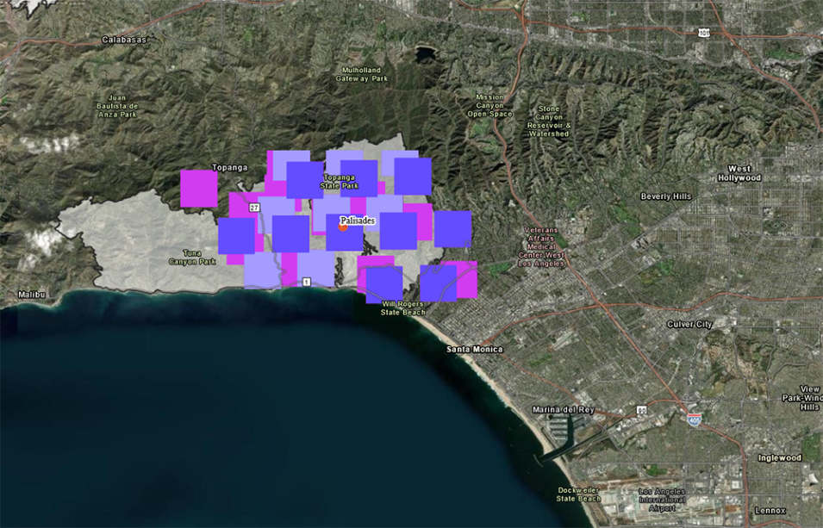
Objective
Show that Spatial Web based DT interoperability can support many types of services & access different types of data.
Global Imagery Browse Services (GIBS) APIs -
Global satellite imagery
Access using IEEE Spatial Web Protocol
DIGITAL TWIN
DATA
This image shows the first satellite-based fire detections in Pacific Palisades, CA, as they appeared on the FIRMS US/Canada map on Jan. 7, 2025. Credit: NASA FIRMS.
How to incorporate the WMTS Schema
How to support the RESTful protocol

Slide 56
OGC WMTS standard document
The OGC Web Map Tile Service (WMTS) standard defines a protocol for serving geospatial map tiles over the web. It provides a standardized way for clients to request and receive map tiles from a server, ensuring interoperability and scalability. The document includes specifications for both procedure-oriented (KVP and SOAP) and resource-oriented (RESTful) architectural styles.
Key Components of WMTS:
Tiling Scheme: A fixed grid system with specified bounds and resolutions for consistent tile generation.
Service Endpoints: Descriptions of how clients can request tiles using RESTful URIs, KVP (Key-Value Pair), or SOAP (Simple Object Access Protocol).
Metadata: The service provides metadata, often in XML (Capabilites document), describing the available layers, tile matrix sets, formats, and styles.
Standardized Formats: Tiles are typically served as PNG, JPEG, or other raster formats

Slide 57
HSML schema compatibility with WMTS schema
To fully achieve compatibility, we need to:
Map WMTS elements to the HSML schema.
Support both XML and JSON formats.
Implement and validate the required WMTS operations (GetCapabilities, GetTile, GetFeatureInfo).
Refer to the OGC WMTS schema for detailed specifications.
Python library "xmltodict"
Dictionary Structure
Python library “json"
XML
JSON
WMTS
HSML

Slide 58

RESTful Protocol
Principles of the Representational State Transfer (REST) architectural style: (AWS, 2024)
Uniform interface. Server transfers information in a standard format (HSML)
Statelessness. Server completes every client request independently of all previous requests.
Layered system. The client can connect to other authorized intermediaries between the client and server, and it will still receive responses from the server. Servers can also pass on requests to other servers.
Cacheability. Support caching.
Code on demand. Servers can temporarily extend or customize client functionality by transferring software programming code to the client.
Notes:
Support caching, which is the process of storing some responses on the client or on an intermediary to improve server response time.

Slide 59
Use Cases
Use Case 1. Lander of SpaceX and a JPL Rover
What do we need from each other?
What do we need to communicate? Position, attitude, images…
Lander – Camera, decide what to do. (Example: sees big rock, or very steep, find flat area)
JPL – uses DARTS
SpaceX – uses ???
Use Case 2. Satellite interacting with Ground Base
Endurance Rover to satellite – satellite location, signal strength, sun location, thermal condition, antenna pointing correctly
Use Case 3. Satellite Constellation, 2 satellites interacting with each other

Slide 60
Space Companies using Digital Twin Technology
SpaceX
Dragon Capsule Spacecraft
Siemens NX software on the design of entire rocket, to ensure that their rocket designs are fully functional by simulating motion.
To design and test their Starlink satellite internet constellation.
To optimize the design and testing of its Starship spacecraft.
Lockheed Martin
On NASA’s OSIRIS-REx Mission
NVIDIA to Build Digital Twin of Current Global Weather Conditions for NOAA
Sierra Space
Siemens Xcelerator platform and its DT technology to support its Dream Chaser

Slide 61
Use Cases
Data to be exchanged
Position/rotation
Speed
Sun location
Signal frequency
Signal strength
Sensor data
Status of instruments
Satellite Telemetry data (Satellite’s health, Status of instruments, payload data)
Can our protocol cover it?
Simulation tools used for DT
Unity
Unreal Engine
Omniverse
DARTS (JPL)
Siemens Nx, Teamcenter
…
How do we interface with those?

Slide 62
DID Method
Primary Choice:
did:key
Reason: It’s fast, lightweight, and doesn’t require hosting a website or interacting with a blockchain. No domain registration, no storage, and no costs.
How this would work with Kafka:
To create a DID – use app or a CLI tool (can build a CLI tool with python)
Tool generates a key pair (public + private key)
Creates DID from the public key (like did:key:xyz123)
Your private key stays secret, and the DID becomes your public identifier
Notes:
The unique identifier is generated through a cryptographic process, this makes it impossible to guess the underlying key or DID

Slide 63
Safety and Trustworthiness in the Spatial Web
“A verifiable and trusted identity is an essential necessity to enable the interactions, transactions, and transportation between people, places, or things.”
“Distributed Ledger Technologies enable a world where every identity, contract, transaction, and currency can be trusted and verified.”
“To register the identity of any user, space, or asset on the SW, an individual or organization must first create an account and request a globally unique “decentralized identifier” (DID) based on W3C Standards.”
René, G., & Mapes, D. (2019). The Spatial Web.

Slide 64
Safety and Trustworthiness in the Spatial Web
“Safety & Trustworthiness in the Spatial Web is enabled by Governance”
The main concepts for Governance are:
Credentials – used for authentication and identity – who can access a domain, and how can they interact with it
Norms – act as a principle of conduct or right action over domains
Contracts – binding agreement used to dictate activities and relationships among domains
4 aspects of trust between parties intermediated by digital technologies:
Authenticity – SWIDs (unique identifier)
Integrity
Confidentiality – HSTP
Privacy – Design principle

Slide 65
Credentials in Kafka
Verifying credentials, identities, and access rights requires a combination of cryptographic techniques, authentication protocols, and access control mechanisms.
Credential Verification, Domain Identity, and Access Control in Kafka:
Issue Decentralized Identifiers (DIDs) for producers, consumers, and brokers.
Use Verifiable Credentials (VCs) to grant roles like "producer" or "consumer" for specific topics.
Authenticate users using DID-Auth (challenge-response).
Check role-based access for producers/consumers.
Use encryption and signing for message confidentiality and integrity.

Slide 66
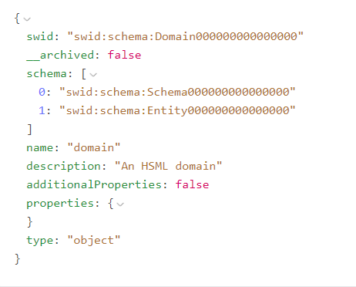
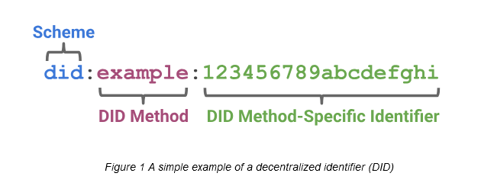
SWID and DID
The Identifier for the HSML schema, according to the Spatial Web standard, is the SWID. The Spatial Web Identifier (SWID) is a Decentralized Identity (DID) that conforms to W3C did-core, https://www.w3.org/TR/did-core/.
NO EXISTING SWID METHOD
USE AN EXISTING DID METHOD
Notes:
However,

Slide 67
DID Methods
The most used DID methods to generate the unique identifier are:
did:key
did:web
did:ethr
The unique identifier is generated through a cryptographic process, this makes it impossible to guess the underlying key or DID
Notes:
The unique identifier is generated through a cryptographic process, this makes it impossible to guess the underlying key or DID

Slide 68
DID Methods
Criteria | DID:ETHR | DID:WEB | DID:KEY
Privacy | Medium – Transactions are on a public Ethereum ledger, but can use zk-SNARKs for privacy. | Low – Relies on centralized control of DNS or domain hosting. | Low – No on-chain record, but depends on how keys are handled.
Easiness to Implement | Medium – Requires an Ethereum wallet and knowledge of smart contracts. | Easy – Requires ownership of a domain name and a simple JSON file hosted at a URL. | Easy – Purely key-based, no blockchain required.
Storage Needed | High – Stores state on Ethereum, costly for large datasets. | Medium – DID document is stored in a simple JSON file on the domain's web server. | Low – No storage required as it’s entirely key-based.
Notes:
The unique identifier is generated through a cryptographic process, this makes it impossible to guess the underlying key or DID

Slide 69

Spatial Web Ontology Entries
ENTITIES are the base items used across the Spatial Web in HSML
The Spatial Web ontology defines several classes. All classes are types of the Entity base class:
ACTIVITY
AGENT
CONTRACT
CHANNEL
CREDENTIAL
DOMAIN
HYPERSPACE/SPACE
TIME
HSML encodes ENTITIES in a format, e.g., JSON-LD

Slide 70
Agent has goals, senses, and responds, i.e. Lunar Rover
AGENT
Agent is a type of Domain. Agents can also sense other Domains
Activity is an action performed by an Agent
Agent can send messages through
the Channel
i.e. Lander, Rover, Moon surface
A Domain info can be sent through the Channel
CHANNEL
Channel contains messages related to an Activity
i.e. Leave the Lander
DOMAIN
ACTIVITY
A Domain can perform an Activity.
An Activity can be performed on a Domain
Domain references a Hyperspace
A Credential is made by a Domain (domain authority)
A Contract is done for an Activity
Activities take Time to be carried out
A Credential parties to a Contract
CREDENTIAL
CONTRACT
HYPERSPACE
TIME
Notes:
HYPERSPACE: A set of ‘points’ such that, for every ordered pair of points, there is a possibly empty set of ‘paths’ from the first point to the second, and such that there is an ‘identity’ path from every point to itself. Syn: SPACE.

Slide 71
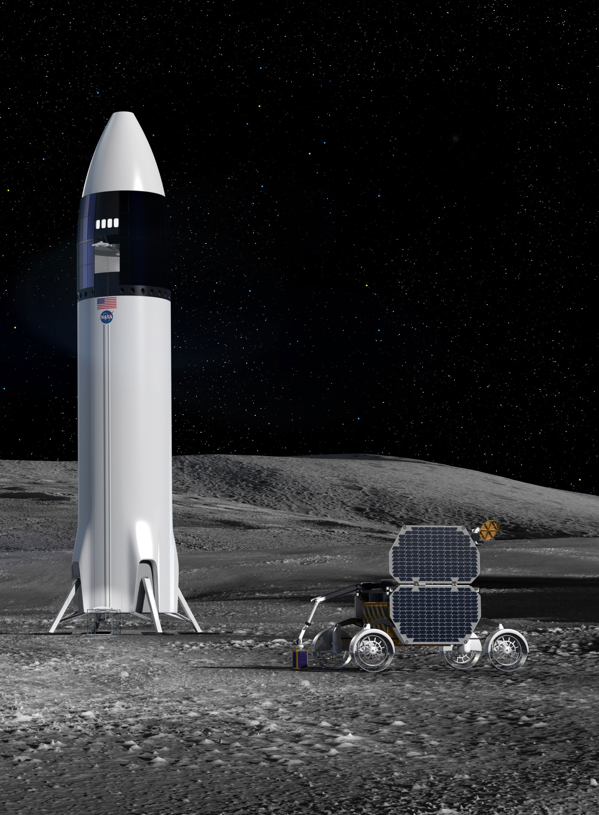
USE CASE:
Two Organizations, Company A and Company B, sign a Contract to work together on a space mission to the Moon.
The Rover of Comp. A will be carried inside the Lander of Comp. B. (Agents)
Once they reach the Moon, the Rover will leave the Lander. To make sure this Activity is developed without any problem, Comp. B needs to work with the model of the Lunar Rover and run some simulations.
A Credential is issued by Comp. A, authorizing Comp. B users (Person) to have access to the 3D Model of their rover for a Period of 3 Months (Time).
The model of the Lunar Rover is in Unreal, and the model of the Lander is in Omniverse; both have a Moon surface environment modelled. The Hyperspace must consider, the location (the Moon), and the appropriate coordinate systems and transforms needed to go from one platform to the other.
All the messages and communications related to this Activity are carried out in a Channel.

Slide 72
Organization: Company A
Channel: Communication between Comp A & B for Activity 1
Organization: Company B
Person: User 1
Person: User 2
Agent: Unreal Lunar Rover 3D Model
Agent: Omniverse Lunar Lander 3D Model
Activity 1: Leave the Lander
Credential: Ownership by Comp. A
Contract: Between Comp. A & B for Activity
Credential: Ownership by Comp. B
Credential: For Comp. B to use temporally Lunar Rover
Hyperspace: Moon, Coordinate System, Transform Unreal-Omniverse
USE CASE
Time: Period of 3 Months
Time: Activity Duration

Slide 73
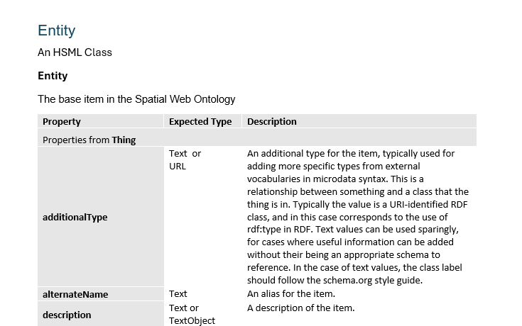
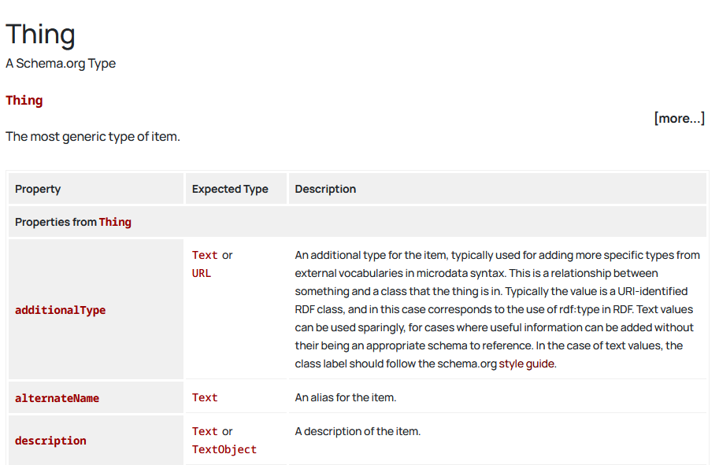
HSML Types Structure
Document currently under construction
Schema.org webpage

Slide 74
Spatial Web Safety and Security
“Safety & Trustworthiness in the Spatial Web is enabled by Governance”
Credentials, Norms & Contracts are the main concepts for Governance
Credentials – used for authentication and identity – who can access a domain, and how can they interact with it
Norms – act as a principle of conduct or right action over domains
Contracts – binding agreement used to dictate activities and relationships among domains
4 aspects of trust between parties intermediated by digital technologies:
Authenticity – SWIDs (unique identifier)
Integrity
Confidentiality – HSTP
Privacy – Design principle

Slide 75
Credentials in Kafka
Verifying credentials, identities, and access rights requires a combination of cryptographic techniques, authentication protocols, and access control mechanisms.
Credential Verification: Use VCs, DIDs, JWTs or ACLs.
Domain Identity: Use DIDs.
User Access Control: Check ACLs, DID VCs, or JWT tokens.
Domain Capabilities: Check DID Documents, VCs, or API responses
Credential Verification, Domain Identity, and Access Control in Kafka:
Issue Decentralized Identifiers (DIDs) for producers, consumers, and brokers.
Use Verifiable Credentials (VCs) to grant roles like "producer" or "consumer" for specific topics.
Authenticate users using DID-Auth (challenge-response).
Check role-based access for producers/consumers.
Use encryption and signing for message confidentiality and integrity.

Slide 76
SWID – DID (Decentralized Identifier)
The Spatial Web Identifier (SWID) is a Decentralized Identity (DID), so it does not rely on central authorities, it is a self-sovereign identity.
The unique identifier is generated through a cryptographic process, this makes it impossible to guess the underlying key or DID
How this would work with Kafka:
To create a DID – use app or a CLI tool (can build a CLI tool with python)
Tool generates a key pair (public + private key)
Creates DID from the public key (like did:key:xyz123)
Your private key stays secret, and the DID becomes your public identifier

